Slide 1

Hourly Energy Consumption Forecasting
P-562 : Hourly Energy Consumption Forecasting

Slide 2
👥 Mentor’s Name & Team Members
Mentor:
Karthik Muskula
Prajwal A N
Team:
Ayush Sonawane
Anurag Gundapi
Shreya Chaurasiya

Slide 3
📊 Dataset Details
Source: PJM Hourly Electricity Consumption Data
Duration: June 2002 – August 2018
Size: ~143,207 rows × 2 columns
Key Variables:
Datetime: Timestamp of recorded consumption
PJMW_MW: Hourly electricity consumption (in Megawatts)

Slide 4
🎯 Objective
Business Context:
PJM Interconnection LLC is a regional transmission organization (RTO) managing electricity supply for over 65 million people across multiple U.S. states. This project leverages historical hourly energy consumption data (in MW) from PJM’s public database to forecast future demand.
Key Goals:
Forecast hourly electricity consumption for the next 30 days to enhance operational efficiency and optimize generation & distribution.
Identify consumption patterns across time of day, seasons, and holidays to understand variations such as summer vs. winter demand.
Evaluate long-term trends and detect shifts in regional usage behavior.
Provide actionable insights to help utilities balance supply-demand, reduce operational costs, prevent shortages, and support sustainable energy planning.
outcome Accurate demand forecasts will enable data-driven decision-making, minimize energy waste, and ensure a stable and reliable power supply to consumers.

Slide 5
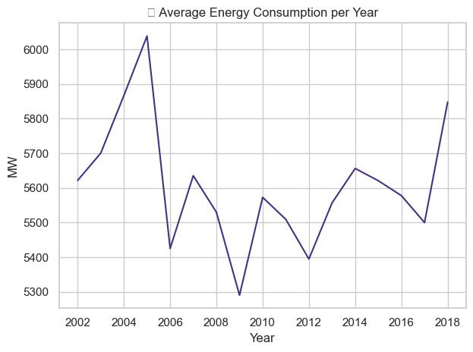
📈 Yearly Consumption Trend
Graph: Average Energy Consumption per Year (2002–2018)
Insights:
Consumption peaked in 2005, reaching over 6,000 MW on average.
Noticeable drop after 2005, possibly due to energy efficiency improvements or economic changes.
Lowest consumption observed around 2009, coinciding with the global recession.
A recovery trend is visible after 2010, with a sharp rise in 2018.

Slide 6
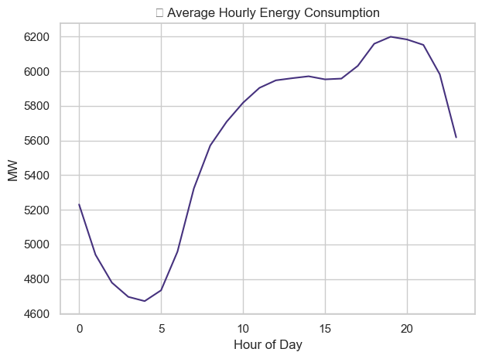
⏳ Hourly Consumption Pattern
Graph: Average Energy Consumption by Hour of Day
Insights:
Peak demand occurs around 6–7 PM, likely due to residential evening activities (lighting, cooking, heating/cooling).
Lowest demand recorded between 2–5 AM, when most people are asleep and industrial activity is minimal.
Gradual rise starts around 5–6 AM, marking the beginning of the workday.

Slide 7
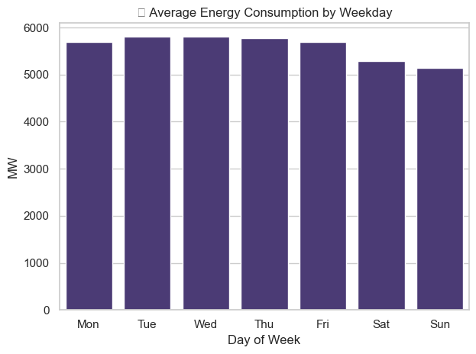
📅 Weekly Consumption Pattern
Graph: Average Energy Consumption by Day of Week
Insights:
Weekdays (Mon–Fri) have slightly higher energy usage, mainly driven by industrial and commercial activities.
Weekends (Sat–Sun) show a small dip in demand, consistent with reduced business operations.
Monday often starts high due to accumulated weekend demand, while Sunday is typically the lowest day.

Slide 8
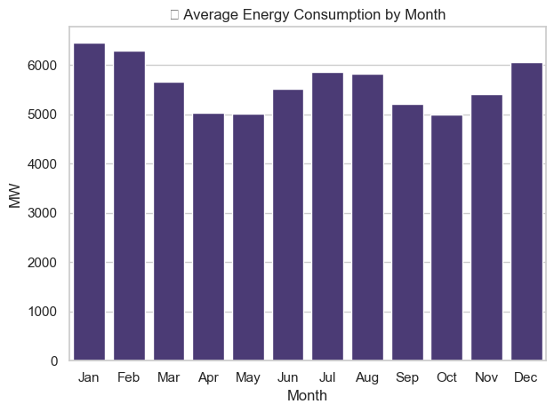
🌦 Monthly & Seasonal Consumption Pattern
Graph: Average Energy Consumption by Month
Insights:
Highest consumption observed in July–August, driven by air conditioning usage during peak summer.
Second peak in January, mainly due to heating demand in winter.
Dips in April and October, when moderate weather reduces the need for HVAC (heating, ventilation, and cooling).
Clear bimodal seasonal trend reflecting distinct summer and winter peaks

Slide 9
⚙ Feature Engineering
Created time-based features: hour of day, day of week, month, season, holiday flag.
Generated lag features (past 24, 48, 72 hours) for time series memory.
Added rolling window statistics (mean, std dev) to capture short-term trends.
Normalized data using MinMaxScaler for LSTM compatibility.

Slide 10
⚙ Model Preparation
Data split: Train (80%) & Test (20%), last year as test set.
Reshaped input for LSTM format → (samples, timesteps, features).
Tried multiple models:
SARIMAX – Captured seasonal trend, moderate accuracy.
XGBoost – Strong for short-term predictions.
LSTM– Best for sequential patterns, chosen as final model.

Slide 11
Data Preprocessing
Handled missing timestamps and filled missing values (interpolation).
Resampled to hourly granularity.
Created time-based features (hour of day, day of week, month, holidays).
Scaled numerical values using MinMaxScaler for models like LSTM.

Slide 12
Linear Regression
Approach: A simple machine learning model that predicts energy consumption based on a linear relationship between features and the target. Works well for trends but not for capturing complex seasonality.
Performance:
MAE: 156.32
RMSE: 198.59
Insights:
Captures the overall trend of consumption.
Struggles during sharp seasonal peaks or holiday effects.
Suitable as a quick baseline model.

Slide 13
XGBoost
Approach: An advanced gradient boosting algorithm that builds decision trees sequentially to minimize errors. It can handle non-linear relationships and capture complex seasonal patterns better than simple regression.
Performance:
MAE: 150.24
RMSE: 194.41
Insights:
Performs better than Linear Regression in capturing variations.
Handles sudden changes in consumption more effectively.
Still misses some extreme peaks, but is closer to actual values than simpler models.

Slide 14
Moving Average
Approach: Uses the 7-day rolling average of past consumption values (168 hours) to forecast the next value, shifted by 1 to prevent data leakage. It smooths out short-term fluctuations to capture overall trends.
Performance:
MAE: 656.84
RMSE: 820.29
Insights:
Works well for identifying general consumption trends.
Poor at predicting sudden spikes or drops due to weather, holidays, or unusual events.
Performance is significantly worse than advanced models like LSTM or XGBoost.

Slide 15
Simple Exponential Smoothing (SES)
Approach:
Uses a weighted average of past observations with exponentially decreasing weights.
Recent data points have more influence on the forecast.
Performance:
MAE: 1,086.38
RMSE: 1,277.65
Insights:
Captures level/trend moderately well, but fails to adapt to seasonal variations or abrupt changes.
Performs worse compared to more sophisticated models like LSTM or XGBoost.
Suitable for stable datasets without strong seasonality.

Slide 16
Holt’s Linear Trend
Approach:
Extends simple exponential smoothing by adding a trend component.
Forecast = Level + Trend, updated at each time step.
Performance:
MAE: 4,090,111.41
RMSE: 4,723,060.33
Insights:
Extremely poor performance for this dataset — huge errors indicate that the model was unable to capture seasonal and hourly fluctuations.
Trend-only approach is insufficient for high-frequency, seasonal energy data.
Shows why seasonal components or advanced ML/DL models are needed.

Slide 17
Holt-Winters Method
Approach:
Triple Exponential Smoothing: accounts for level, trend, and seasonality.
Seasonal period set to 24 hours to capture daily energy usage cycles.
Performance:
MAE: 1,034.86
RMSE: 1,255.26
Insights:
Performs better than Holt’s Linear Trend but still far less accurate than ML/DL approaches.
Seasonal component improved results, but additive seasonality couldn’t fully capture complex energy demand patterns across different seasons and holidays.

Slide 18
ARIMA Model
Approach:
AutoRegressive Integrated Moving Average with parameters:
p=2 → two lag terms (autoregressive)
d=1 → first differencing to make the series stationary
q=2 → two lag terms for moving average
Captures short-term dependencies and trends in time series.
Performance:
MAE: 1,000.00
RMSE: 1,185.33
Insights:
Performs better than Holt’s methods but still not competitive with XGBoost or LSTM.
Captures general trends but struggles with abrupt seasonal fluctuations.
Limited ability to adapt to holiday/seasonal patterns without external regressors.

Slide 19
SARIMA Model
Approach:
Seasonal AutoRegressive Integrated Moving Average with Exogenous Factors
Parameters:
Non-seasonal: p=1, d=1, q=1
Seasonal: P=1, D=1, Q=1, m=24 (daily seasonal cycle in hourly data)
Designed to handle both short-term autocorrelation and 24-hour seasonality.
Performance:
MAE: 14,650.11
RMSE: 16,673.55
Insights:
Very poor performance compared to other models.
Struggles to capture large fluctuations in hourly consumption.
Possibly over-smoothed and lagged behind rapid demand changes.

Slide 20
LSTM Model
Approach:
Long Short-Term Memory (LSTM) – a deep learning recurrent neural network designed to learn time dependencies.
Input: Past 24 hours of scaled hourly consumption.
Output: Next 1 hour forecast.
Architecture:
LSTM layer: 50 units, ReLU activation.
Dense output layer (1 neuron).
Optimizer: Adam, Loss: MSE.
Data scaled using MinMaxScaler.
Performance:
MAE: 62.54
RMSE: 82.39
Insights:
Outperformed all other models by a large margin.
Captures both short-term fluctuations and seasonal trends effectively.
Best suited for forecasting tasks with high-frequency time series.

Slide 21
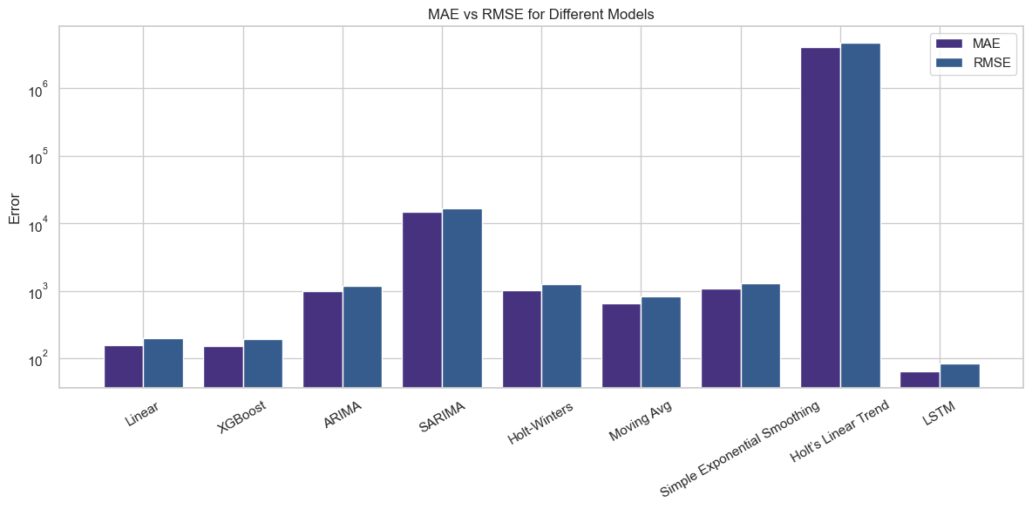
Model Performance
"Among all tested models, LSTM achieved the lowest MAE (62.54) and RMSE (82.39), significantly outperforming traditional statistical and machine learning approaches."

Slide 22
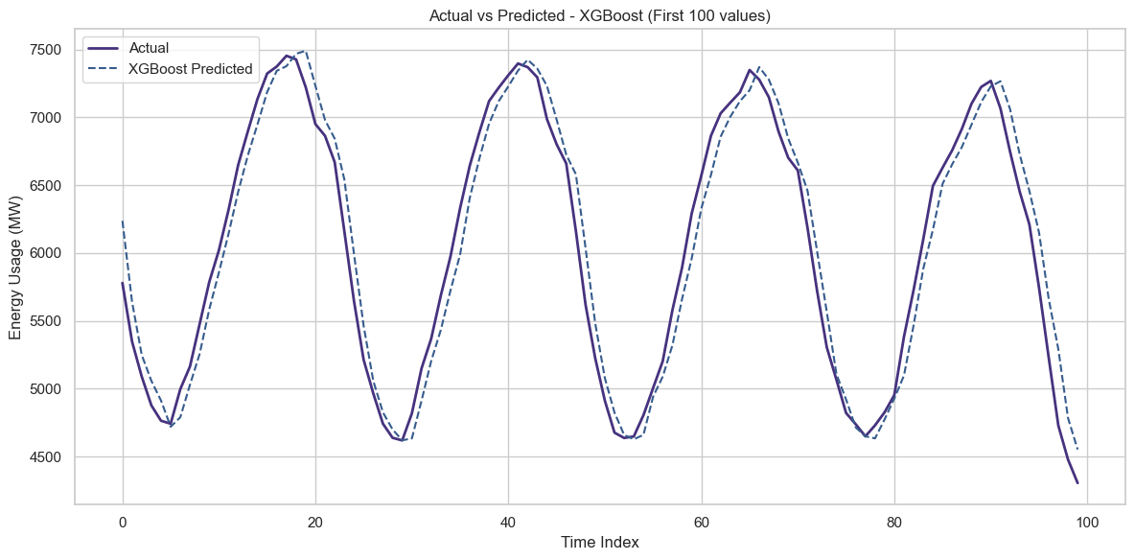
Actual vs Predicted
XGBoost tracks the general trend well, but shows small deviations during peak and low demand hours

Slide 23
LSTM 30-Day Forecast Insights
Key Observations:
Model predicts strong daily seasonality for the next month, matching historical demand behavior.
Hourly peaks remain consistent — highest demand expected in morning & evening hours.
No unusual spikes or drops, suggesting stable demand in the forecast horizon.
Implications:
Grid operators can schedule maintenance during predicted low-demand hours.
Energy suppliers can align generation and storage with peak cycles to minimize costs.

Slide 24
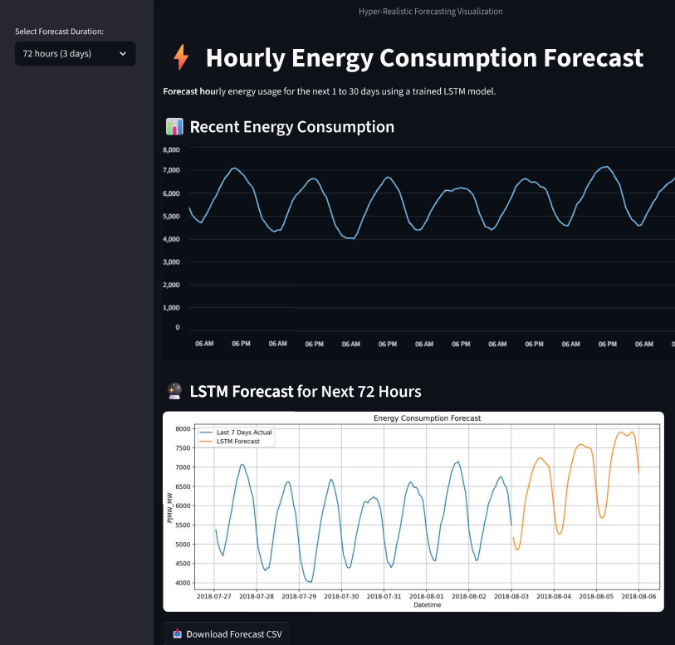
💻 Screenshot of the Deployed App (Streamlit)
End-to-end LSTM-powered forecasting tool built with Streamlit, enabling real-time demand predictions and visualizations.

Slide 25
⚠ Challenges Faced
Challenge | Impact | Solution
Data gaps / Missing values | Could distort training & forecasts | Applied forward fill + interpolation for consistency
Seasonal variation handling | High variance between daily/weekly cycles | Used LSTM with 24-hour window to capture patterns
Model tuning complexity | Risk of overfitting or underfitting | Experimented with hyperparameters, tested 9 models

Slide 26
Thank You

